Slide 1
Employee Data Analysis using Excel
STUDENT NAME:A.SHARMELA
REGISTER NO: 122200228 & asunm110122200228
DEPARTMENT: COMMERCE
COLLEGE: DRBCCC HINDU COLLEGE

Slide 2
PROJECT TITLE
Employee Salary Analysis using Excel

Slide 3


AGENDA
Problem Statement
Project Overview
End Users
Our Solution and Proposition
Dataset Description
Modelling Approach
Results and Discussion
Conclusion
3/21/2024 Annual Review

Slide 4

PROBLEM STATEMENT
1. What specific data do you have (e.g., salaries, job titles, departments)?
2. What kind of analysis are you looking to perform (e.g., salary distribution, comparison by department, trend analysis)?
3. Are there any specific questions or goals for the analysis?

Slide 5

PROJECT OVERVIEW
An employee salary analysis project typically involves examining and interpreting salary data to provide insights into compensation trends, equity, and efficiency.These insights can help to make important decisions on how to improve your HR processes and policies as well as evaluate their business impact. Excel offers a lot of functions for data analysis.A project overview in Excel typically refers to a summary of key details about a project, organized in a spreadsheet format.This overview helps stakeholders quickly understand the project's scope, progress, and critical aspects.
.

Slide 6

WHO ARE THE END USERS?
- HR MANAGER
- FINANCE TEAMS
-EXECUTIVES AND LEADERSHIP
-COMPENSATION ANALYSTS
-EMPLOYEES

Slide 7

OUR SOLUTION AND ITS VALUE PROPOSITION
FORMULA - PERFROMANCE
CONDITIONAL FROMATORMATTING SALAY
GRAPH- DATA VISUALIZTION
FILTER - REMOVE

Slide 8
Dataset Description
ENPMPLOYEE DETAILS - KAGGLE.COM
30 FEATURES
11FEATURES
NAME-TEXT
JOINING YEAR- NUMBERS
GENDER - MALE OR FEMALE
AGE- NUMBERS
SALARY - NUMBERS
WORKER LOCATION - TEXT
EMPLOYEE RATING - NUMBERS
PERFORMANCE - TEXT

Slide 9

THE "WOW" IN OUR SOLUTION
PREFORAMERFORMANCE LEVEL= =IF(K3>=5,"VERY HIGH",IF(K3>=4,"HIGH",IF(K3>=3,"MED","LOW")))
3/21/2024 Annual Review
9

Slide 10
MODELLING
DATA COLLECTION:
- COLLECTED FROM KAGGLE.
FEATURES COLLECTION :
- CONDITIONAL FORMATTING
- SYMBOLS
-MERGE & CENTRE
PERFORMANCE LEVEL
- WITH USING EMPLOYEE RATING COLUNM TO GET PERFORMANCE LEVEL
10

Slide 11
SUMMARY:
- TO FIND THE SALARY OF THE EMPLOYEE BY USING THE EXCEL
- THE RESULTS SHOWN IN THE GRAPH

Slide 12
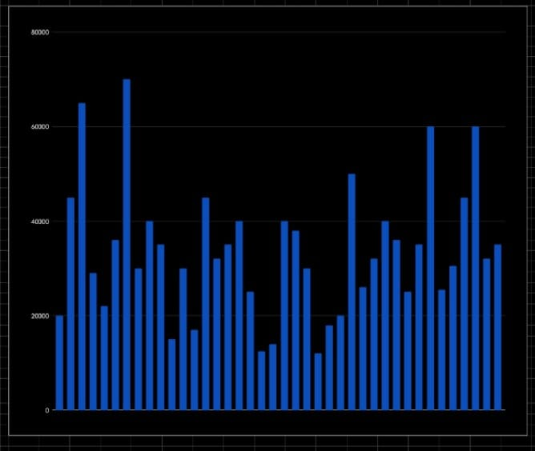
RESULTS
12

Slide 13
conclusion
IN THIS SALARY ANALYSIS THE SOME OF THE EMPLOYEES AGE IS HIGHER IN THE DEPARTMENT OF QUALITY AND SALES .

